Slide 1
DEVOVERFLOW: REDEFINING Q&A PLATFORMS WITH AI INNOVATION
An Ambitious Capstone Project
Introducing DevOverflow, a cutting-edge Q&A platform amalgamating AI technology and innovative features
Eshan Gupta
20BIT0262

Slide 2
PROPOSED ARCHITECTURE FOR THE PROJECT
DevOverflow's architecture is a robust framework centered around NextJS v13.5, MongoDB, and cutting-edge technologies, prioritizing scalability, performance, and maintainability. Its components include:
1. Frontend Layer: Utilizing Next JS and React components, it ensures dynamic user interfaces. Tailwind CSS enables responsive styling for seamless experiences across devices.
2. Backend Infrastructure: Powered by NextJS, it features API routes, server-side form validation, and authentication mechanisms. MongoDB manages data efficiently.
3. AI-Powered Text Generation: Integrated with OpenAI, it delivers instant, accurate answers using NLP techniques for real-time analysis of user queries.
4. Recommendation System: Employing classic algorithms, it suggests relevant content based on user preferences and browsing history.
5. Authentication and Access Control: Managed by Clerk Auth Service, it safeguards user accounts and data stored in MongoDB, ensuring privacy and security.
6. Responsive Design and Performance Optimization: Fully responsive and optimized, employing SSR, ISR, and CSR to enhance performance and adaptability across devices and network conditions.

Slide 3
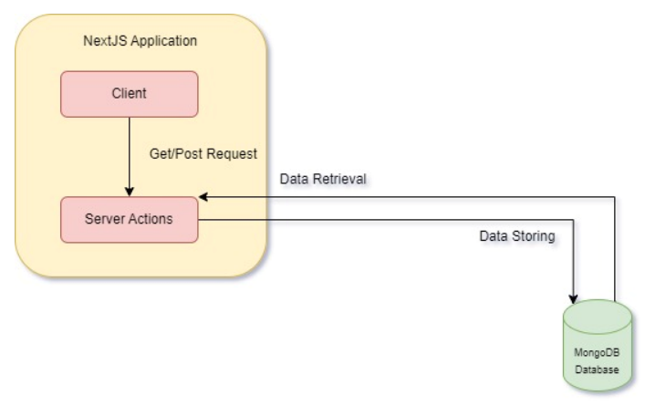
Complete Design and Module Wise Description
Data flow Diagram-:

Slide 4
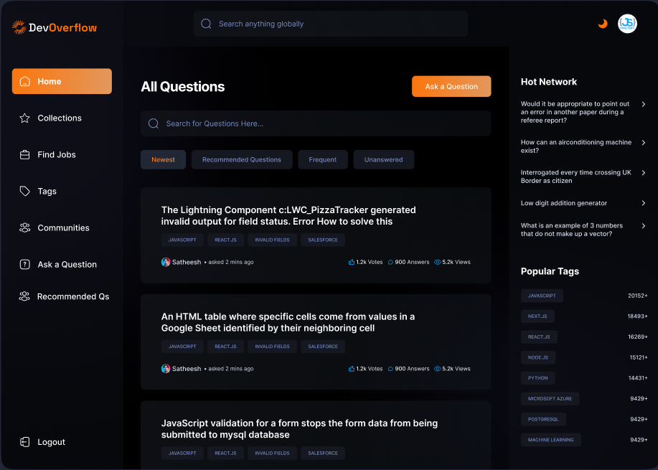
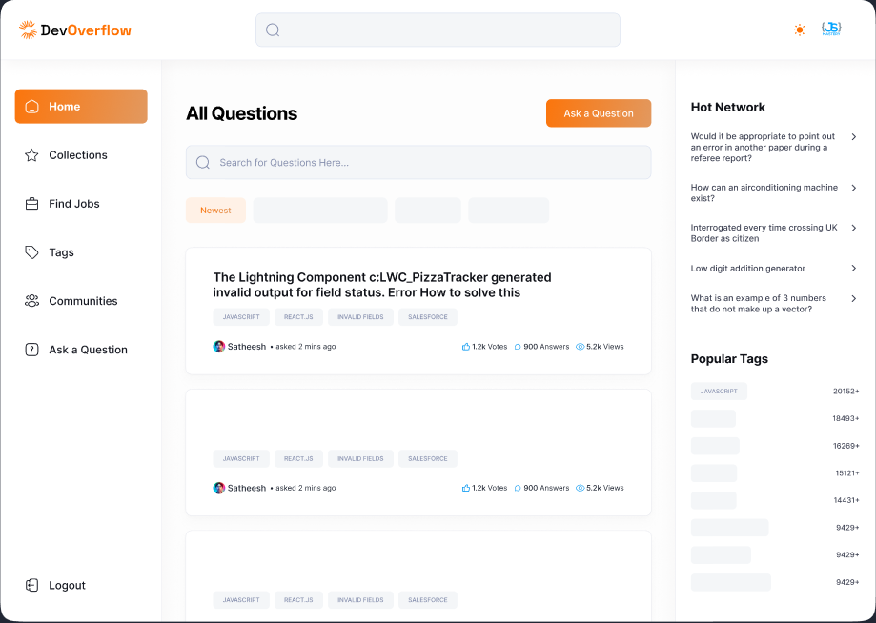
Module Descriptions
HOMEPAGE OF THE WEBSITE

Slide 5
FEATURES OF THE HOMEPAGE 📃
So the homepage of the website will be basically containing all the questions asked by different users in the centre, with a functionality to even search for the questions and also we can group these questions according to latest, most-interacted and some other filters too.
The left bar of the homepage has many sub menu options like Collections, Find Jobs, Tags, Communities and Ask a Question Page. (More on these sections later)
The right bar will be showing us the current popular tags and the number of mentions of these tags and stuffs like that.
User can click on a question and look for the answers of the question or can even answer the question.

Slide 6


…FEATURES OF THE HOMEPAGE 📃
5. There is a local search bar that can be used by the user to search among the questions of the page and any question that has they keywords related to the search, those questions will be displayed.
6. There is a filters option where one can see the newest, recommended, most frequent and unanswered questions.
7. Lastly there is a global search functionality where a user can search for any keywords and any user related to the keyword, or any question or tag related to it will be displayed.

Slide 7
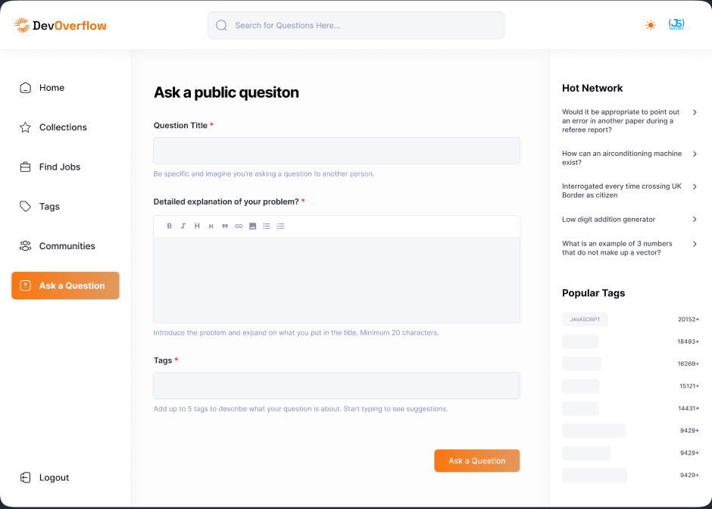
ASK A QUESTION PAGE
So in this page the user will come using the Ask a Question button from the homepage and here the user will be able to ask a public question by providing it a proper title, detailed explanation and tags to the question.
This question’s description can contain a proper code snippet and is markdown enabled, I have used to TinyMCE npm package to enable this feature.
Once the user asks this question the details will be saved in our Database and you will be redirected to homepage.

Slide 8
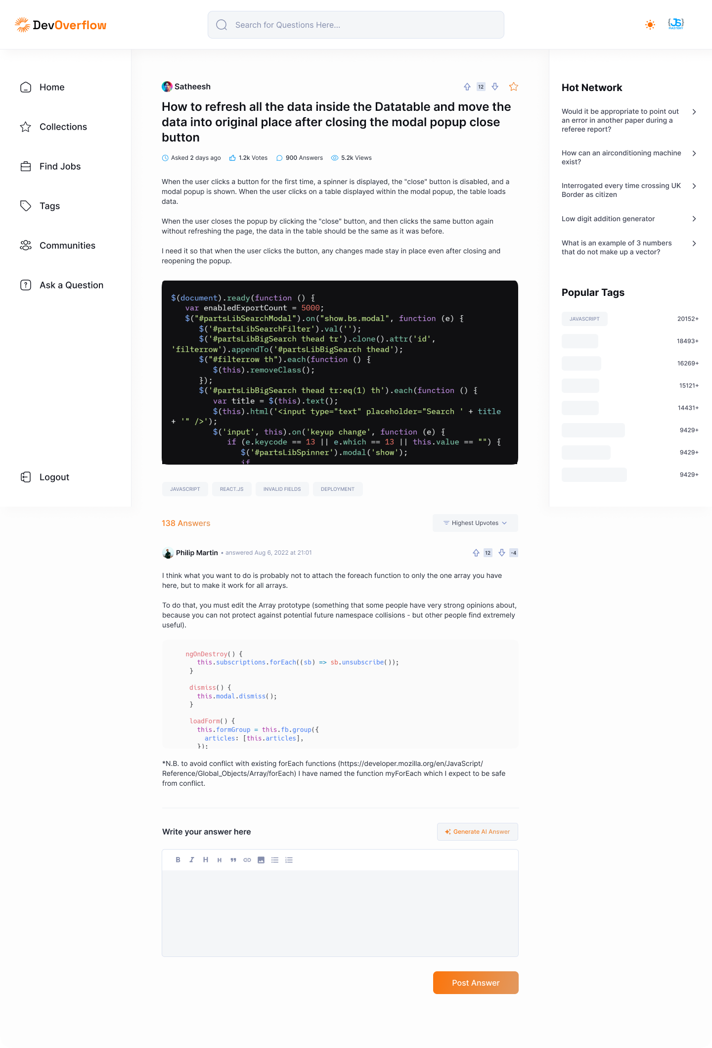
VIEW A QUESTION PAGE
So this page consists of 3 major functionalities-:
Viewing the question in detail with description which wasn’t available in the homepage. The user will be able to understand the question in detail.
The user can see all the answers that are answered by different people of the community.
Lastly the user can either use Generate AI Answer feature and generate the answer using AI for the question asked and then he/she can correct or add to the answer provided by the AI. User can post his/her answer freely under the question.

Slide 9
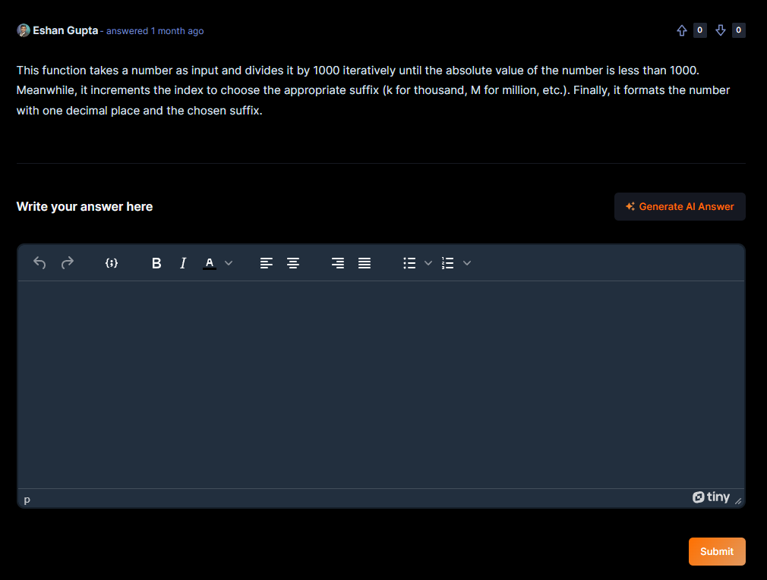
Generate AI Answer Feature
So this feature is integrated using the OpenAI API and costed the website around 6 $ but the feature is really helpful to the users as they can answer the question using this button and edit or alter the response given by OpenAI API.
Once the user has answered the question and is satisfied by the answer he/she can post the answer.

Slide 10

VOTING FUNCTIONALITY
If we look closely then we can see that at the end of each question and answer we are able to see these 3 icons and these 3 icons are for the voting functionality.
Now voting functionality is important for the website for two primary reasons-:
The first one being that the most upvoted answers would help us to find that which answers or questions are the relevant ones.
The second being that the more the user interacts with all of this by upvoting/ downvoting the answers or questions his/her reputation points increase and he starts earning more badges(More on this later).

Slide 11
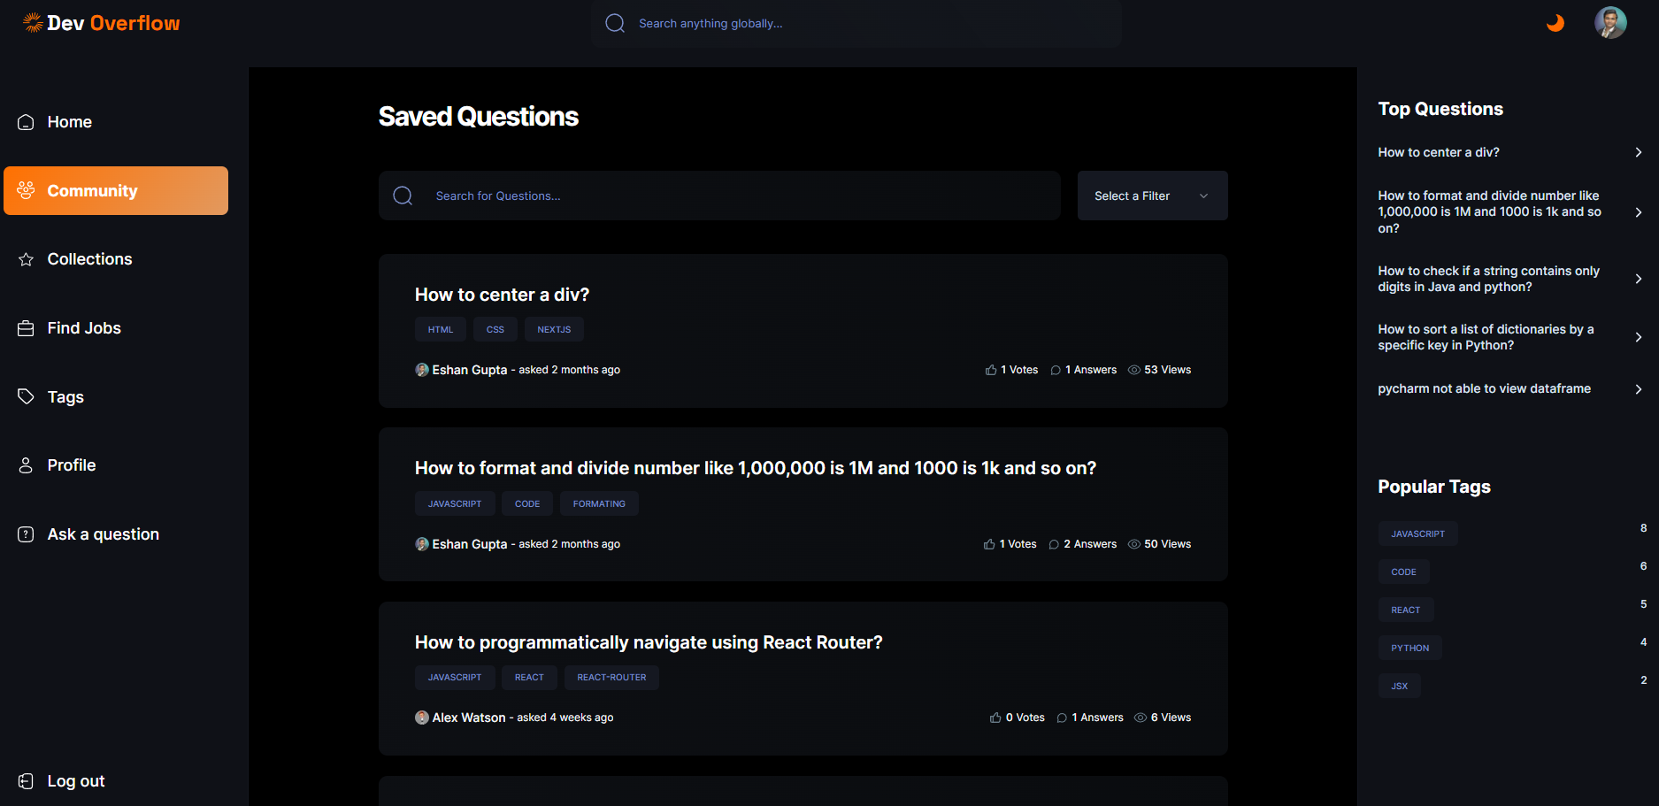
COLLECTIONS PAGE
So there are 3 buttons on this panel upvote and downvote being the two of them, now what does the 3rd button do here?
The 3rd button if pressed that question gets saved to your collections.
And a user can access all of its collections on the collections menu from the left side bar on the homepage and it looks as shown in the image.
Also the local search functionality and the filters work here as well.
Again all of this is being continuously saved into our database and being fetched from their itself.😁

Slide 12
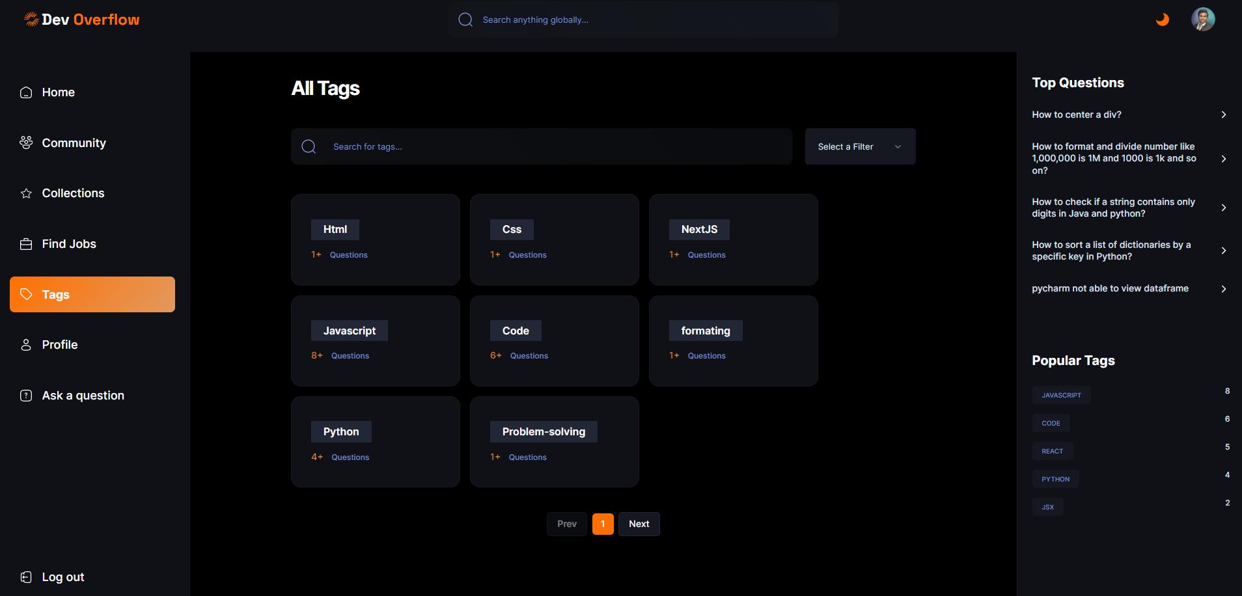
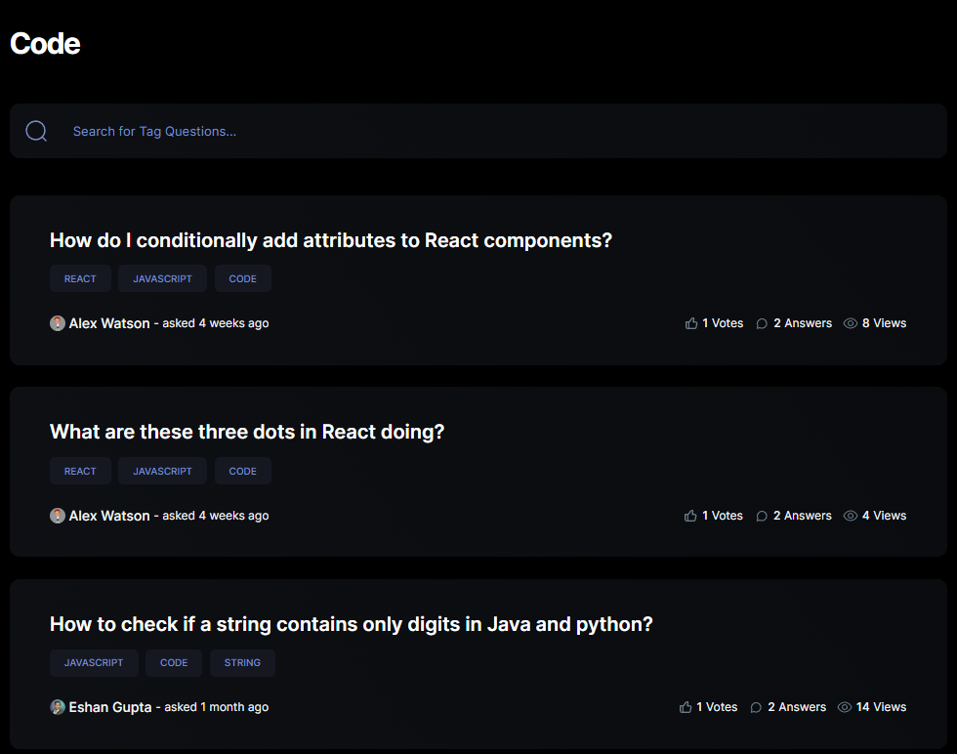
TAGS PAGE AND ITS FUNCTIONALITY
This page will have all the tags and the number of times these tags have been mentioned, so the user will directly be able to visit the questions with tag “#example” from here itself and answer accordingly.
The user will also be able to see the most used tags and can filter the tags accordingly.
The localsearch and the filters work here as well.
Once the user has clicked the tag he she will be redirected to the page with all the questions of the tag and there also the local search works.

Slide 13
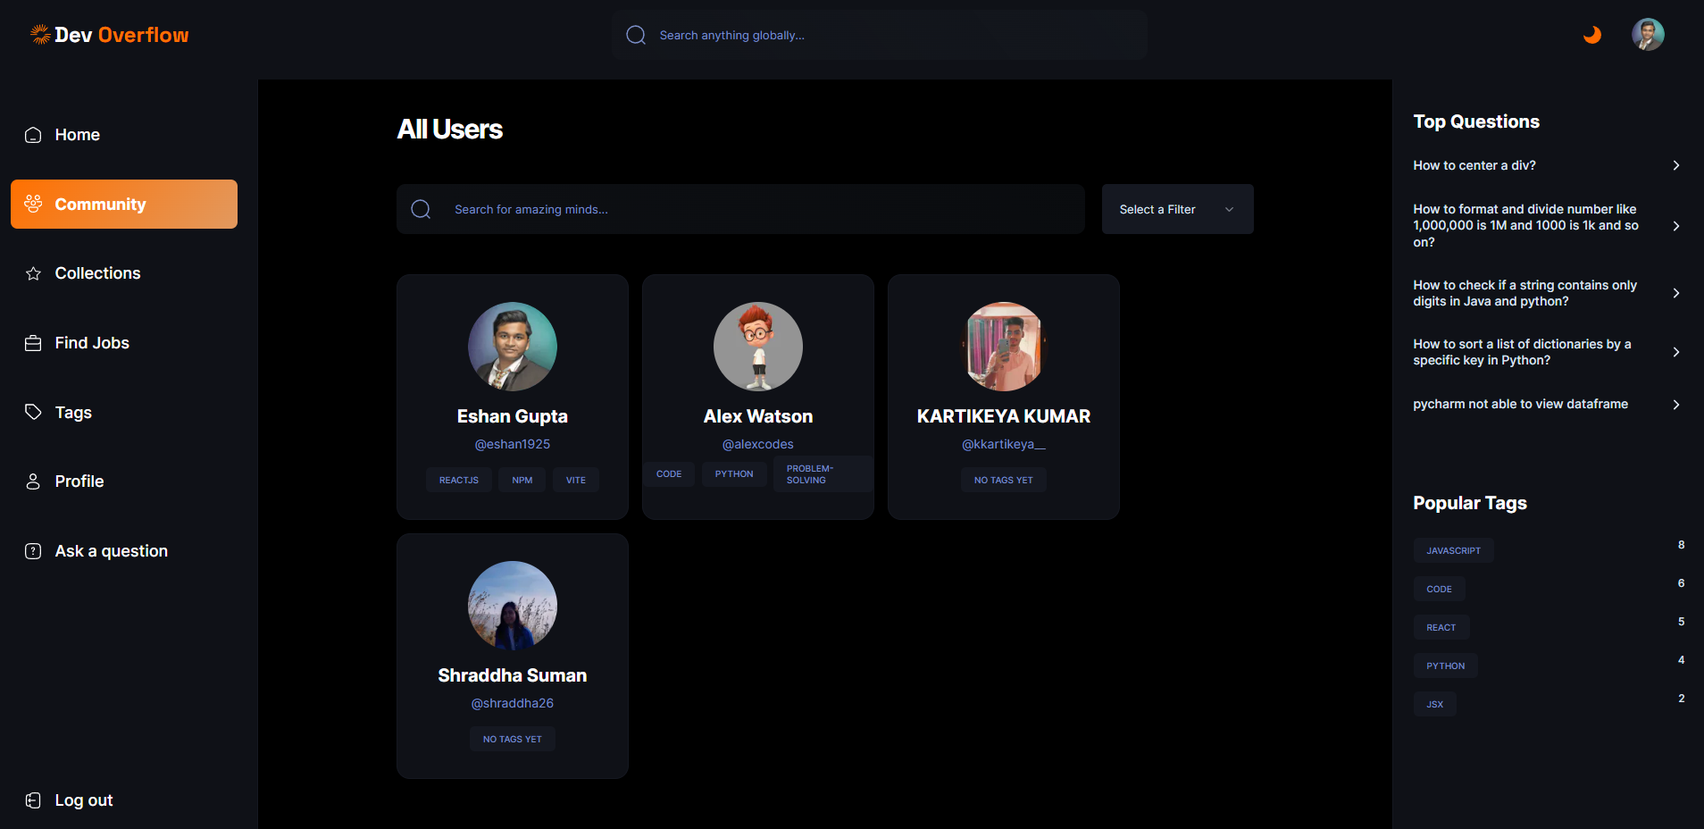
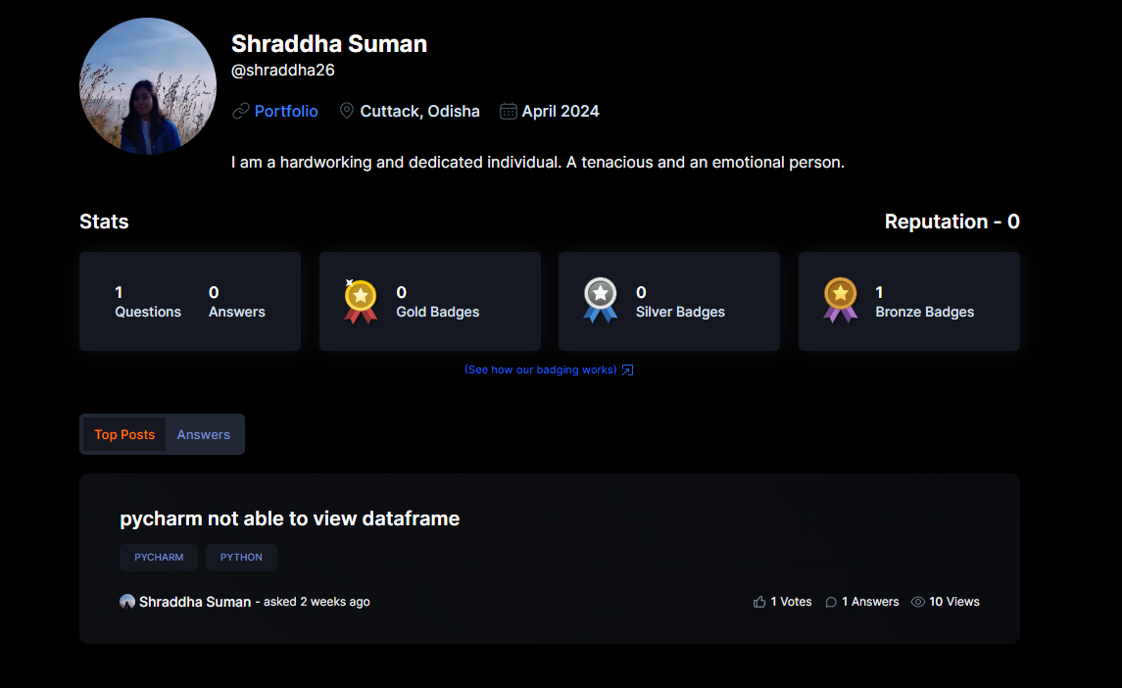
COMMUNITIES PAGE
Here in the communities page the users will be able to see different users and their profile, reputation and badges.
This page will be useful as the name suggests to build up a community of users as the more the people interact with each other the more they will be able to build up a community.
All the users of the website can be searched using filters, names and usernames from this section of the website.
Once if we click a users profile he’she will be redirected to viewing the user’s profile.

Slide 14
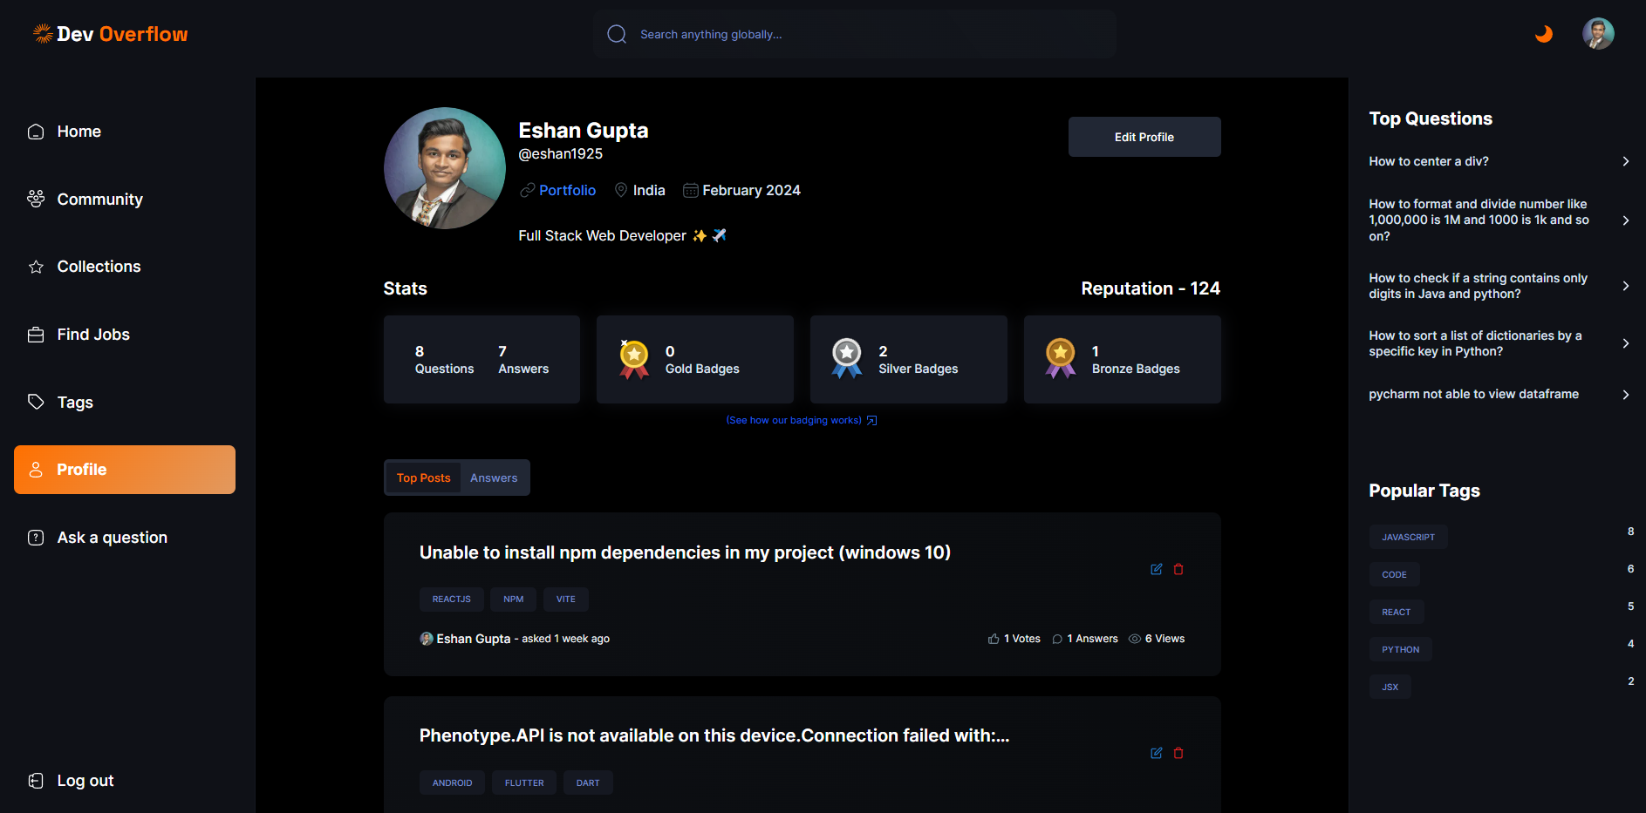
PROFILE PAGE
This is how a user’s profile page is going to be looking if someone else or even the user itself view’s his/her profile.
One can see the stats , the reputations and other stuffs from the profile page.
The questions asked by the users and the answers given by the user can also be seen.
The only difference if a user is viewing his account will be of the edit profile button.

Slide 15
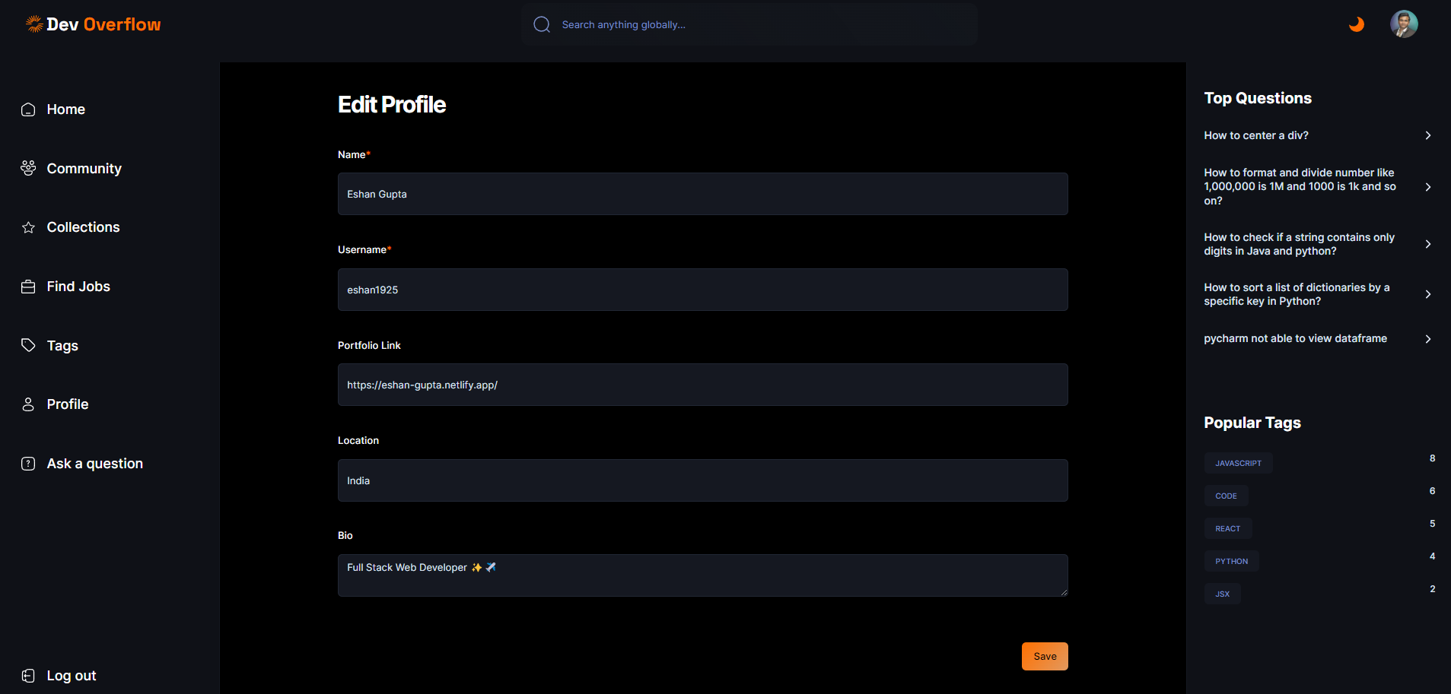
EDIT PROFILE PAGE
This is how the edit profile page will be looking, here the user can come and update his/her details so that it will be visible to other users of the community.
Once all the details are updated user can click on the submit button and the details will get updated on the database.

Slide 16
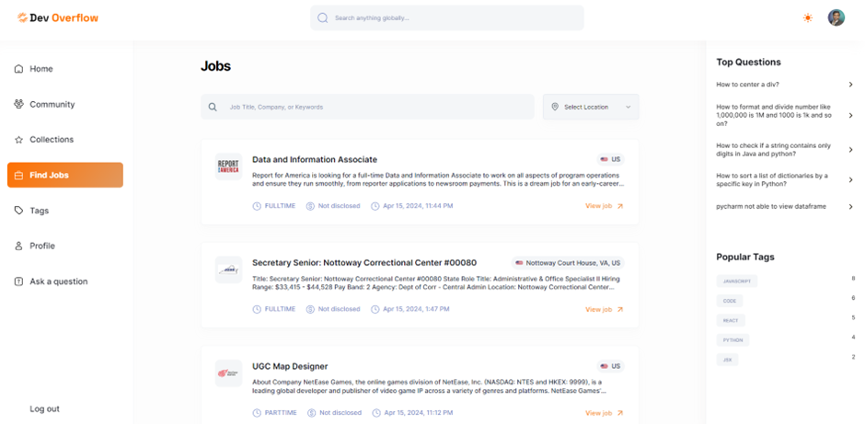
JOBS PAGE
This is how the jobs page will be looking, the user can come here and search for all the new jobs that are available.
The localsearch and the filters feature work here as well.
User can click the view job button and he/she will be redirected to the page where he/she can apply for the job.
We are integrating this feature using the RapidAPI Jobs API.

Slide 17
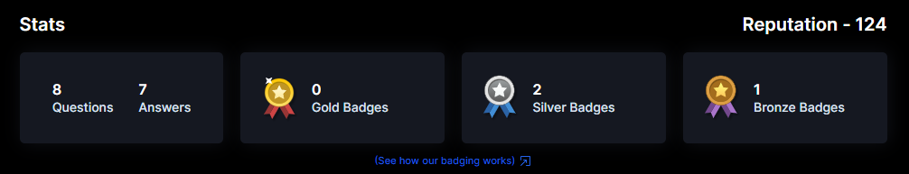
Reputation and badging…
As you would have seen this particular badges and reputation on the view profile page, so this is implemented using the number of interaction a user has.
The reputation is calculated using the parameters like how many questions a user is creating, how many answers is the user giving, how many upvotes and downvotes has he done and stuffs like that. (You get points for each interaction you make)
The badges have been distributed using mainly the number of questions and answers posted, number of views and number of upvotes the user is getting.
For more information on badging the user can visit the following link-:
https://devoverflow-eshan.vercel.app/badge-criteria

Slide 18
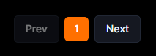
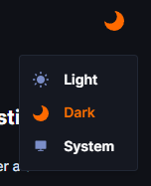
Pagination
Theme Management
As you may have seen that entire website is having these page numbers, so this is also a feature that has been enabled the entire website is having the pagination feature included.
Number of record to be displayed in single page differ from section to section.
Now this is also a very beautiful UI feature that our website provides us with the website is enabled with both light and dark themes.

Slide 19

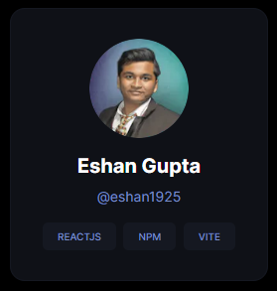
Recommendation Algorithm
As you would have seen that in the main page there is an option of selecting out the Recommended questions for a user.
So each user will be getting the recommended questions based on the top tags they have usually interacted with.
The top tags for a user can be seen on the communities page.
This entire algorithm for recommending the questions works behind the scenes and is coded by me.

Slide 20
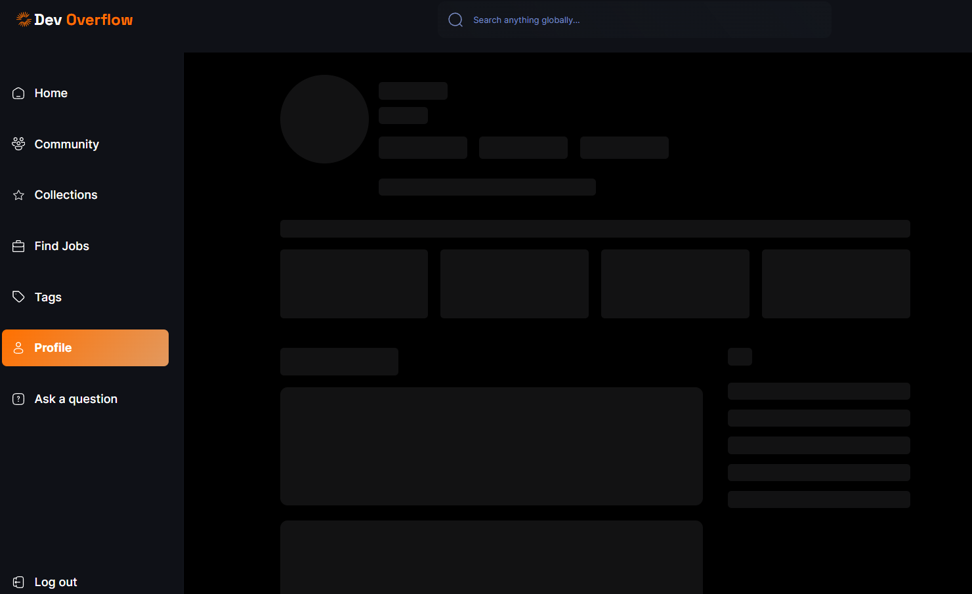
Loading Skeleton effects…
I have also given the functionality across all the pages for loading and that is of a skeleton loading page that you would have usually seen in most of the websites today.
The loading effect can be seen for a tiny amount of time till the time the content has not loaded.
The entire website also has a toast feature where a user is toasted when he/she perform any major action such as posting a question/answer etc.

Slide 21
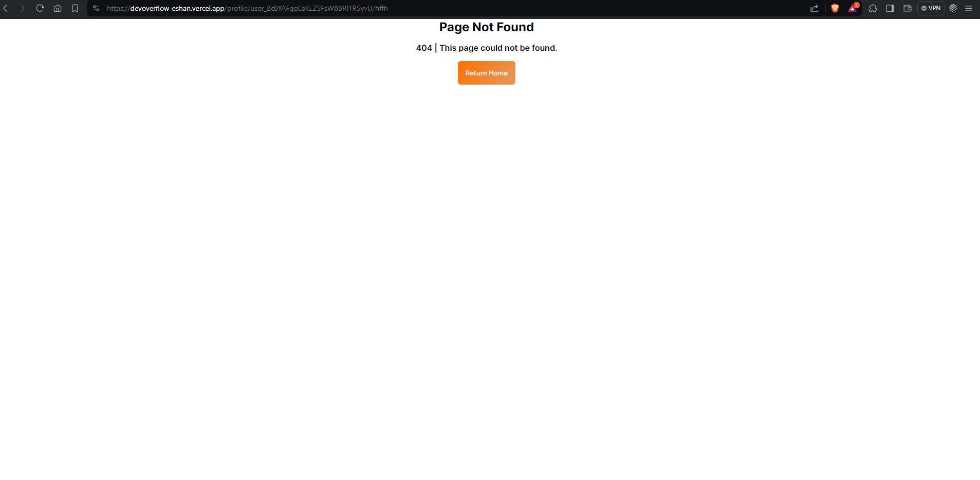
404 Page Not found
Even the tiniest details of the website have been carefully monitored.
If a user just in case visits a link which is associated with the website and is not accessible the user gets a 404 page as shown.

Slide 22
Implementation-:
For showing you the implementation of my website either we can clone this repo and host it locally or can visit the the following link and checkout the globally hosted version of my website-: Repo Link-: https://github.com/eshan1925/stackoverflow_nextjs13
Hosted Website Link-: https://devoverflow-eshan.vercel.app/

Slide 23
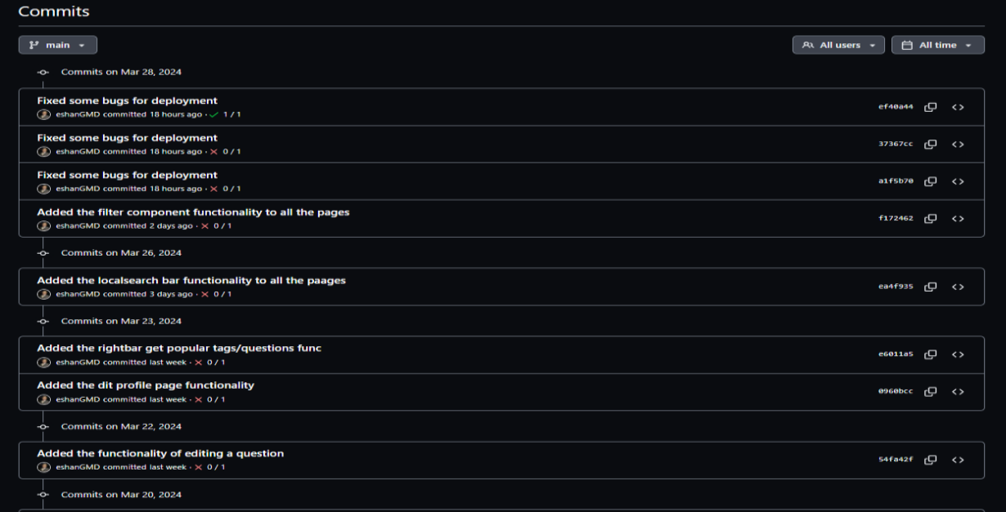
Implementation-:
The whole commit history could be checked to know the progress of the project from time to time.

Slide 24
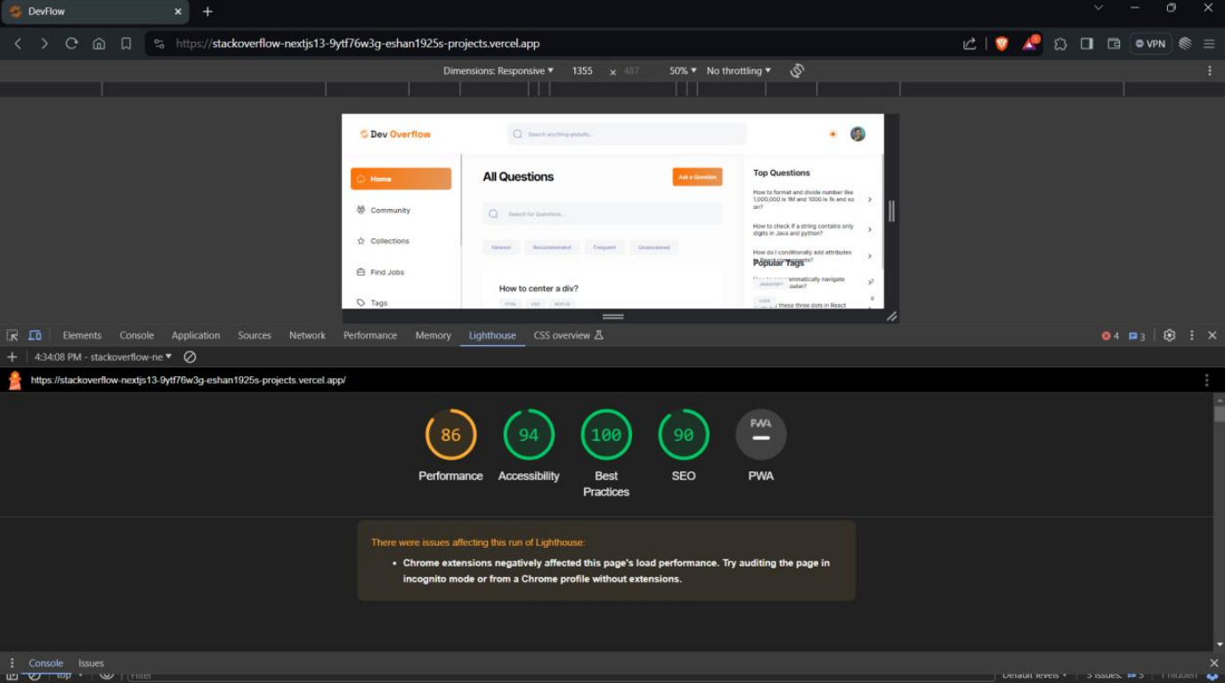
Testing and Performance Metrics-:
Now for testing and performance metrics we have a tool called Lighthouse that is provided to us by google let’s discuss more about this tool-:

Slide 25
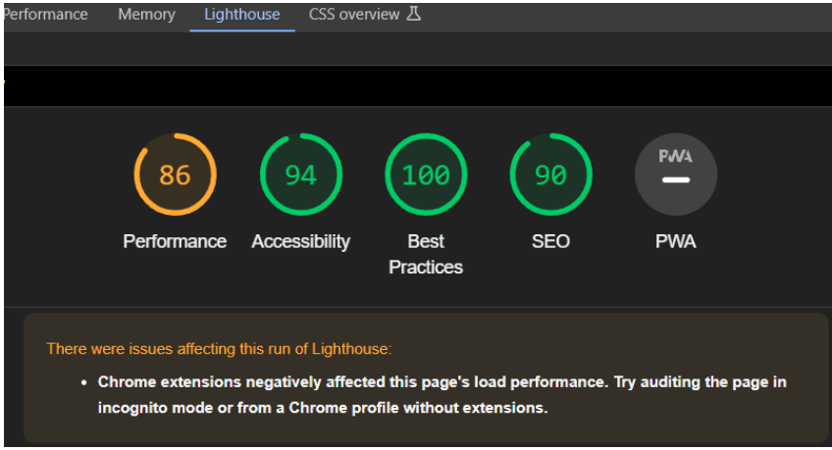
Results from our website-:
Performance: 86 ✓
- Fast loading, smooth experience
- Positive for user engagement & SEO
Accessibility: 94 ✓
- Inclusive website for all users
- Reflects commitment to exceptional UX
Best Practices: 100 ✓
- Perfect score, adheres to all best practices
- Clean, efficient, well-maintained code
SEO: 90 ✓
- Well-optimized for search engines
- Aids organic discovery through search
Overall: Exceptional scores across all categories
- Fast, accessible, well-coded & SEO-friendly
- Lays foundation for successful online presence

Slide 26

THANKYOU
Name- Eshan Gupta
Registration Number- 20BIT0262
Guide Name- Dr. Suganya P.
Date-: 22.04.2024

